Slide 1
Programming I
Packages and JAR
11th lecture

Slide 2
Packets
What are packages and how do we use them?
http://java.sun.com/docs/books/tutorial/java/package/index.html
The JAR tool
http://java.sun.com/docs/books/tutorial/deployment/jar/index.html
11th lecture
Programming I
© Branko Kavšek, Jernej Vičič
slide <number>

Slide 3
Overview
Basic libraries
Packages
JAR
11th lecture
Programming I
© Branko Kavšek, Jernej Vičič
slide <number>

Slide 4
Basic libraries
Java 8 Platform overview
Java Platform, Standard Edition 8 JDK.
JDK version 1.8.0.

Slide 5
Basic libraries
2017: Java 8 and 9 are supported, previous versions:
JDK 1.0 (January 23, 1996)^{[40]}
JDK 1.1 (February 19, 1997)
J2SE 1.2 (December 8, 1998)
J2SE 1.3 (May 8, 2000)
J2SE 1.4 (February 6, 2002)
J2SE 5.0 (September 30, 2004)
Java SE 6 (December 11, 2006)
Java SE 7 (July 28, 2011)
Java SE 8 (March 18, 2014)
Java SE 9 (September 21, 2017)

Slide 6
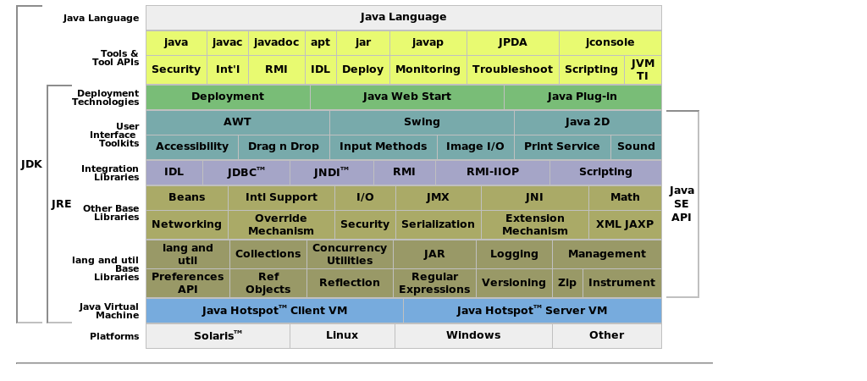

Slide 7
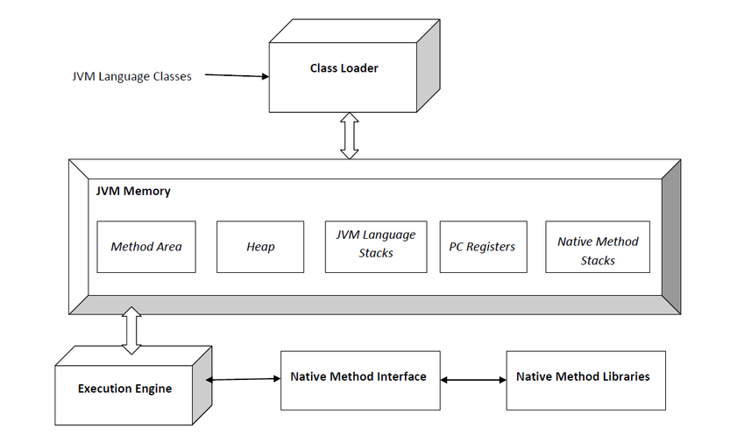

Slide 8
Packages
packages are libraries of Java objects,
you can import a package with the import keyword,
The Java API contains many different packages,
we can also make new packages,
a package is closely linked to the file system directory,
all public classes that are in a directory can be accessed among each other.

Slide 9
Packets
All public classes that are in a directory can call each other.
Package behaves as a directory, all the classes of a package are friends (you can call another method, modify / read properties).
  We must store all classes in the same directory at design time.
Packages can be placed in a Java JAR archive.

Slide 10
Packts - example
import java.util.Vector; // sedaj lahko uporabljamo paket Vector
public class Bla {
public static void main(String argv[]) {
Vector vv = new Vector();
vv.addElement(new Integer(99));
System.out.println((Integer)vv.elementAt(0)); // kličemo
}
}

Slide 11
Packets
package FirstPackage;
public class MyClass{
public static void main(String args[]){
System.out.println(”Ciao!");
}
}

Slide 12
Packets
Content of the example must be saved in the file MyClass.java, which is located in the directory FirstPackage.
Compile file MyClass.java as an ordinary Java program.
The implementation is slightly different:
java FirstPackage/MyClass

Slide 13
Pakets - JAR
Jar is Java Archive.
It is a file format based on the zip and is used to combine multiple files into one.
It is primarily designed to facilitate and speed up the handling of java projects. It handles (in addition to Class files) also images similar rubbish.

Slide 14
Packets - JAR
Make a jar archive:
jar cvf pp.jar FirstPackage/
Start a class in an archive (add to classpath):
java -classpath pp.jar FirstPackage/MyCLass
Executable jar files:
  Open a nerw jar file.
  Find file MANIFEST.MF
  Add the line:
    Main-Class: FirstPackage/MyCLass
  Make a new archive:
  jar cvfm pp1.jar c:\temp\MANIFEST.MF FirstPackage/
  Start:
  java -jar pp1.jar

